Slide 1

SAP Business Technology Platform Solution Diagrams & Icons Guidelines v01
NOTE: Delete the yellow stickers when finished.
See the SAP Image Library for other available images.
SAP Business Technology Platform Core Product Management
March 26, 2021

Slide 3
Terms of Use for the SAP Business Technology Platform Solution Diagrams, Design Elements and Icons (see PDF document)
The SAP Terms of Use found here, along with the terms of use that are specific to the SAP Diagrams, Design Elements, and Icons, below, govern your use of these SAP Materials (as defined in the Terms of Use), and related Content and web pages. Unless otherwise indicated, all capitalized words used below shall have the same meanings given to such words in the SAP Terms of Use.
By attempting to access or use these SAP Materials, You agree that these Terms form a legally binding agreement between You ("You" or "Your") and SAP SE, for and on behalf of itself and its subsidiaries and affiliates (as defined in Section 15 of the German Stock Corporation Act), and You agree to be bound by these terms with respect to your use of the Diagrams and Icons. If You are accessing the SAP Materials on behalf of Your employer in your capacity as an employee, or as a consultant or agent of a third party (this third party in any of these cases being referred to as "Your Company"), You represent and warrant that You have the authority to act on behalf of and bind Your Company to these Terms, and everywhere in this Agreement that refers to 'You' or 'Your' shall also include Your Company. If You do not agree to these terms, do not attempt to access or use the SAP Materials.
You are entitled to (a) access the Diagrams, Design Elements, and Icons, and use these SAP Materials as a reference tool for activities you perform as an individual or as part of your employment, and (b) include these SAP Materials in documents, reports, or other works that you create in direct or indirect support of the deployment or use of SAP products or services (including a third party’s deployment or use of SAP products or services). The above described use is subject to SAP’s policies on the Use of Copyrighted Material found at this page https://www.sap.com/corporate/en/legal/copyright/use-of-copyrighted-material.html including the following conditions set forth in Section II:
The SAP Materials and all copies shall remain at all times the exclusive property of SAP SE and/or an SAP affiliate company.
You must use the SAP Materials without modification (except as may be necessary to resize or otherwise convert the SAP Material to a permitted format).
In the event You use more than an incidental number or terms or definitions in your work, You must include the statement indicating the SAP Materials are “Used with permission of SAP SE” in a prominent location.
You may not use the SAP Material in any offensive manner or context, for example in a way that is defamatory, disparaging or libelous to, or otherwise presents false or misleading information regarding, SAP or any other party, or its or their products or services; in conjunction with obscene or pornographic material; in a manner that suggests bias based on race, national origin, gender, sexual orientation, or religion; or in any manner that would be illegal under applicable law.
You may not imply any SAP sponsorship, affiliation or endorsement.
You may not use the SAP Material for a purpose competitive with SAP or its products unless otherwise clearly permitted by applicable law.
You may not use the SAP corporate logo.
No use of other SAP trademarks is granted under this section. For information regarding use of SAP trademarks, see http://www.sap.com/corporate/en/legal/trademark.html.
You are not permitted to:
Archive or download the Diagrams, Design Elements, and Icons, or archive or download data to create a derivative database or work, other than as expressly permitted herein; or
Use the Web Site or any SAP Materials to provide products or services to anyone outside your organization, except as expressly provided herein or with the prior written authorization of SAP.

Slide 4
SAP Business Technology Platform Solution Diagrams & Icons Guidelines Readme
Official SAP design guidelines & icons to create SAP Business Technology Platform Solution Diagrams using Microsoft PowerPoint.
Reach a better and faster understanding of SAP Business Technology Platform end-to-end solution scenarios as customer, partner, client, solution architect, project lead or developer by using graphical diagrams for visual learning.
Accelerate learning curve for customers & partners with common iconography and solution diagram design following SAP UX principles (Fiori design).
Use the Microsoft PowerPoint slide deck SAP-BTP_official-solution-diagrams-and-icons_v01.pptx available for download on public wiki page SAP Business Technology Platform Solution Diagrams & Icons
Download the SAP Business Technology Platform icons collection ZIP containing service icons and SAP icons in PNG and SVG format.
Find diagram elements or sample diagrams that you need
Create your own SAP Business Technology Platform solution diagram for own purposes including twitter, sap.com blogs, project documentation, interactions with clients, workshops
For more information see public wiki SAP Business Technology Platform Solution Diagrams & Icons

Slide 5
SAP Business Technology Platform Solution Diagrams & Icons Guidelines Table of Contents
SAP Business Technology Platform Service Icons
SAP Business Technology Platform service icons (via ZIP resource link)
SAP Icons
SAP Product Logos
Third-Party Logos
Solution Diagram Design Elements
Colors
Areas, Cardinality Markers, Environment Areas
Text in Flex Grey
Text in L0-blue, Emphasis and Semantic Colors
Connectors, Arrows & Lines
Numbers
Solution Digram Design Guidelines
Elements for Protocols, Interfaces and Trust Relationships
Style to Show Inner Part of Application or Service
Arrow Directions
Dos and Don’ts
Tips and Tricks
How to create Colored Icons in 5 Steps
Comparison with SAP Technical Architecture Modeling (TAM) Block Diagrams
Community Support
Solution Diagram Samples
Resources
Version Change History

Slide 6
SAP Business Technology Platform Solution Diagrams SAP Business Technology Platform con collection (ZIP resource)

Slide 7
SAP Business Technology Platform Service Icons and SAP icons Download ZIP-File
The SAP Business Technology Platform service icons (with and without circle, in PNG and SVG format) and a subset of SAP Icons in grey are provided in a separate ZIP file:
Download here: sap-btp-icon-collection.zip
link URL: https://d.dam.sap.com/a/s9tyyJJ
For additional information see the contained readme.txt
NOTE: By default we recommend using PNG-service-icons in MS PowerPoint slides instead of SVGs as SVG icons cannot be filled with background colors as easily as PNGs. SAP Business Technology Platform service icons on top of boxes inside solution diagrams must be filled with white or black color, so that the underneath border line gets hidden.

Slide 8
SAP Business Technology Platform Solution Diagrams Other SAP Icons

Slide 9






































SAP Business Technology Platform Solution Diagrams & Icons Other SAP Icons (from SAP Icon Font, TNT Font based on SAP Fiori Iconography)
See more: https://experience.sap.com/fiori-design-web/icons
Most used icons:
On-premise
system
system, host
User
Admin
Monitor
Laptop
iPhone
iPad
Application or Package
Database
E-mail
Security
SAPUI5
SAPUI5
Global Account
Subaccount
Locked
Unlocked
Linked
Unlinked
Process
Cloud Foundry Space
Entitlement
Solution
Upload
Download
Cloud
Wi-Fi
Feed
Public Key
Private Key
Key Pair
Datastore
CPU
RAM / Memory
SDK
Identity Provider
Timesheet

Slide 10













































































SAP Business Technology Platform Solution Diagrams & Icons Other SAP Icons (from SAP Icon Font, TNT Font based on SAP Fiori Iconography)

Slide 11
SAP Business Technology Platform Solution Diagrams & Icons SAP Product Logos

Slide 12













SAP Business Technology Platform Solution Diagrams & Icons SAP Product Logos (white background style)

Slide 13












SAP Business Technology Platform Solution Diagrams & Icons SAP Product Logos (black background style)

Slide 14
SAP Business Technology Platform Solution Diagrams Third-Party Logos

Slide 15





SAP Business Technology Platform Solution Diagrams & Icons Third-Party Logos – Cloud Foundry
Notes:
Image Sources:
https://www.cloudfoundry.org/logo/

Slide 16





SAP Business Technology Platform Solution Diagrams & Icons Third-Party Logos – Cloud Foundry (black background)
Notes:
Image Sources:
https://www.cloudfoundry.org/logo/

Slide 17














SAP Business Technology Platform Solution Diagrams & Icons Third-Party Logos – Others
Kubernetes Gardener
Notes:
Image Sources:
https://commons.wikimedia.org/wiki/File:Microsoft_Azure_Logo.svg
https://github.com/kubernetes/kubernetes/tree/master/logo
https://github.com/gardener
https://github.com/cncf/artwork/tree/master/cncf
https://cloud.google.com/press/ > Google Cloud Platform Logos

Slide 18









SAP Business Technology Platform Solution Diagrams & Icons Third-Party Logos – Others (black background)
Kubernetes Gardener
Notes:
Image Sources:
https://commons.wikimedia.org/wiki/File:Microsoft_Azure_Logo.svg
https://github.com/kubernetes/kubernetes/tree/master/logo
https://github.com/gardener
https://github.com/cncf/artwork/tree/master/cncf
https://cloud.google.com/press/ > Google Cloud Platform Logos
Microsoft Azure > Direct contact (Team Microsoft Azure Business Cloud & Enterprise Group)

Slide 19
SAP Business Technology Platform Solution Diagrams Elements for Microsoft PowerPoint Slides

Slide 20
SAP Business Technology Platform Solution Diagrams & Icons MS PowerPoint Elements: Colors (white background style)*
* SAP Business Technology Platform Solution Diagrams are based on a selected subset of SAP Fiori Design Colors (Quartz Light), see more …
R | G | B | HEX | COLOR | Color Name | Purpose | Fiori Color
10 | 110 | 209 | 0A6ED1 |  | L0-blue | SAP Business Technology Platform L0 area and service names | Primary2
7 | 77 | 146 | 074D92 |  | L1-blue | SAP Business Technology Platform L1 area | Secondary6
5 | 59 | 112 | 053B70 |  | L2-blue | SAP Business Technology Platform L2 area | Primary2 desaturated
127 | 127 | 127 | 7F7F7F |  | Fix grey | SAP Icons, separator lines | not defined
255 or 89 | 255 or 89 | 255 or 89 | #ffffff or #595959 |  | Flex grey / white = SAP Theme Palette Color „Black, Text 1, Lighter 35%“ | Texts, arrows | not defined
15 | 130 | 143 | 0F828F |  | Emphasize aqua | Emphasize diagram elements | Accent Color 7
192 | 57 | 159 | C0399F |  | Emphasize purple | Emphasize diagram elements | Accent Color 4
16 | 126 | 62 | 107E3E |  | Semantic green | Emphasize diagram elements | SemanticPositive
233 | 115 | 12 | E9730C |  | Semantic orange | Emphasize diagram elements | SemanticCritical
187 | 0 | 0 | BB0000 |  | Semantic red | Emphasize diagram elements | SemanticNegative

Slide 21
SAP Business Technology Platform Solution Diagrams & Icons MS PowerPoint Elements: Colors (white background style)*
* SAP Business Technology Platform Solution Diagrams are based on a selected subset of SAP Fiori Design Colors (Quartz Light), see more …
R | G | B | HEX | COLOR | Color Name | Purpose | Fiori Color
10 | 110 | 209 | 0A6ED1 |  | L0-blue | SAP Business Technology Platform L0 area and service names | Primary2
7 | 77 | 146 | 074D92 |  | L1-blue | SAP Business Technology Platform L1 area | Secondary6
5 | 59 | 112 | 053B70 |  | L2-blue | SAP Business Technology Platform L2 area | Primary2 desaturated
127 | 127 | 127 | 7F7F7F |  | Fix grey | SAP Icons, separator lines | not defined
255 or 89 | 255 or 89 | 255 or 89 | #ffffff or #595959 |  | Flex grey / white = SAP Theme Palette Color „Black, Text 1, Lighter 35%“ | Texts, arrows | not defined
15 | 130 | 143 | 0F828F |  | Emphasize aqua | Emphasize diagram elements | Accent Color 7
192 | 57 | 159 | C0399F |  | Emphasize purple | Emphasize diagram elements | Accent Color 4
16 | 126 | 62 | 107E3E |  | Semantic green | Emphasize diagram elements | SemanticPositive
233 | 115 | 12 | E9730C |  | Semantic orange | Emphasize diagram elements | SemanticCritical
187 | 0 | 0 | BB0000 |  | Semantic red | Emphasize diagram elements | SemanticNegative

Slide 22
SAP Business Technology Platform Solution Diagrams & Icons MS PowerPoint Elements: Areas (white background style)
SAP Business Technology Platform, Area L0
L0-blue RGB(10/110/209)
Non-SAP-BTP Area Flex Grey: SAP Theme Palette Color „Black, Text 1, Lighter 35%“
NOTE: automatically becomes white on black background slides
Area L1
L1-blue: RGB(7/77/146)
Area L2, dotted line
L1-blue: RGB((7/77/146)
Primary Emphasize Area aqua
Aqua: RGB(15/130/143)
Emphasize Area aqua, dotted line
Non-SAP-BTP Area,
dotted line
Flex Grey: SAP Theme Palette Color „Black, Text 1, Lighter 35%“
Area L2
L2-blue: RGB(5/59/112)
Area L2, dotted line
L2-blue: RGB(5/59/112)
Secondary Emphasize Area purple
Purple: RGB(192/57/159)
Emphasize Area purple, dotted line

Slide 23
SAP Business Technology Platform Solution Diagrams & Icons MS PowerPoint Elements: Areas (white background style)
SAP Business Technology Platform, Area L0
L0-blue RGB(10/110/209)
Non-SAP-BTP Area Flex Grey: SAP Theme Palette Color „Black, Text 1, Lighter 35%“
NOTE: automatically becomes white on black background slides
Area L1
L1-blue: RGB(7/77/146)
Area L2, dotted line
L1-blue: RGB((7/77/146)
Primary Emphasize Area aqua
Aqua: RGB(15/130/143)
Emphasize Area aqua, dotted line
Non-SAP-BTP Area,
dotted line
Flex Grey: SAP Theme Palette Color „Black, Text 1, Lighter 35%“
Area L2
L2-blue: RGB(5/59/112)
Area L2, dotted line
L2-blue: RGB(5/59/112)
Secondary Emphasize Area purple
Purple: RGB(192/57/159)
Emphasize Area purple, dotted line

Slide 24
SAP Business Technology Platform Solution Diagrams & Icons MS PowerPoint Elements: Cardinality Markers
SAP Business Technology Platform, Area L0 , L0-blue RGB(10/110/209)
SAP Business Technology Platform, Area L1 L1-blue: RGB(7/77/146)
SAP Business Technology Platform Area L2 L2-blue: RGB(5/59/112)
Secondary Emphasize Area purple
Purple: RGB(192/57/159)
Primary Emphasize Area aqua Aqua: RGB(15/130/143)
Non-SAP-BTP Area Flex Grey: SAP Theme Palette Color „Black, Text 1, Lighter 35%“

Slide 25

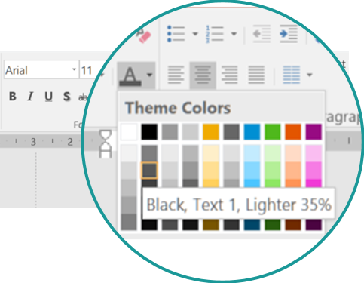
SAP Business Technology Platform Solution Diagrams & Icons MS PowerPoint Elements: Text in Flex Grey (Standard Font: Arial*)
* Use standard font Arial instead of BentonSans to avoid rendering issues when sharing slide decks across channels
Copy and paste these text objects
Text in Flex grey*: SAP Theme color “Black, Text 1, lighter 35%”, Arial font
Non-service Icon text
Arial 11 bold / Flex grey: SAP Theme color “Black, Text 1, lighter 35%”)
1
Non-service Icon text
2
Descriptive text element
Arial 11 / Flex grey: SAP Theme color “Black, Text 1, lighter 35%”
Descriptive text
3
L1-L2 area header text
Arial 11 bold / Flex grey: SAP Theme color “Black, Text 1, lighter 35%”
L1-L2 area header
Component title
4
LANDSCAPE AREA TITLE
Arial 14, bold, Flex Grey: SAP Theme color “Black, Text 1, lighter 35%”
*NOTE: Flex grey automatically becomes white on black background slides
LANDSCAPE AREA TITLE

Slide 26

SAP Business Technology Platform Solution Diagrams & Icons: MS PowerPoint Elements: Text in L0-blue, Emphasis and Semantic Colors
* Use standard font Arial instead of BentonSans to avoid rendering issues when sharing slide decks across channels
Copy and paste these text objects
Service Icon Text
SAP Business Technology Platform Service icon text
Arial 11 / L0-blue: RGB(7/77/146)
Service name
subtitle
Text in Emphasize Colors
Text in emphasize aqua: Arial 11 / RGB 15/130/143
Text in emphasize aqua
Text in emphasize purple: Arial 11 / RGB 192/57/159
Text in emphasize purple
Text in Semantic Colors
Text in semantic red: Arial 11 / RGB 187/0/0
Text in semantic red
Text in semantic green: Arial 11/ RGB 16/126/62
Text in semantic green

Slide 27
SAP Business Technology Platform Solution Diagrams & Icons MS PowerPoint Elements: Connectors, Arrows and Lines
Flex grey
Emphasize aqua
Emphasize purple
Semantic green
Semantic red
Elbow Connectors
Line Connectors
Arrow Types
Standard: Request-response from client to server (solid line)
Information-flow from data source to target (dashed line)
Bidirectional arrow, for example, a mutual trust relation (solid line)
Landscape Separators
Firewall
Arrow Annotation
Flex grey: SAP Theme color “Black, Text 1, lighter 35%”
annotation text
IMPORTANT: color in Fix grey RGB(127/127/127), but not in Flex grey to keep same on black background style!

Slide 28
SAP Business Technology Platform Solution Diagrams & Icons MS PowerPoint Elements: Numbers
Numbers (circled) L1-blue: RGB (10/110/209)
Numbers (trapezoid) L1-blue: RGB (10/110/209)
1
2
3
4
5
1
2
3
4
5
6
7
8
9
10
6
7
8
9
10

Slide 29
SAP Business Technology Platform Solution Diagrams Design Guidelines

Slide 30






SAP Business Technology Platform Solution Diagram Design Guidelines Arrow Directions in SAP Business Technology Platform Solution Diagrams
Request-Response Channel: Solid arrow from client (triggering agent) to server (point-to-point connectivity scenario, simplified)
Data Flow Channel: Dashed arrow from source (triggering agent) to target database (data replication scenario, simplified)
Application request arrow with solid line
SAP Business Technology Platform HANA database as a service
Data flow arrow with dashed line
Service request
System
On-premise database (source)
HTTPS
SAP Gateway
Data Replication Tool
Database
OData
TCP
ODBC
SAPUI5 application
Connectivity service
Cloud Connector
Protocol
Exposed OData service interface
Connectivity service
Cloud Connector
Protocol
ODBC interface needed for replication process
Mutual Trust Relation: Solid arrow in both directions
Bidirectional RFC: Solid arrow in both directions ( point-to-point connectivity scenario with Cloud Connector 2.10)
Mutual trust relation
Backend system
Protocol
SAP BTP, Cloud Foundry Environment
RFC
SAP S/4HANA Cloud system
mutual trust
Cloud Connector
Bidirectional RFC via tunnel connection
SAP Cloud Identity (Identity Provider)
Notes:
Agents perform operations; they read and write data and communicate with other agents. (Question: Who does something?)
Storages are passive; they only hold data that is accessed by agents. The arrows indicate direction of data flow. (Q: Where is the data?)
Channels are used by agents to communicate with each other. Arrows indicate the direction of data flow, the “R” indicates who initiates the request and then waits for the response. (Q: Which agents communicate? What data and which requests do they exchange?)
Block diagrams show a snapshot view of a system on instance level; to indicate multiple agents or storages, use three dots or stack the nodes.

Slide 31


SAP Business Technology Platform Solution Diagram Design Guidelines Graphical Elements to depict Application Protocols, Interfaces and Trust Relationships
Application Protocol
Sample 1
Sample 2
Application protocol
HTTP
Cloud Connector
Application Server ABAP
Application client
SAPUI5 Application
RFC
RFM/BAPI
< protocol name >
Application protocol
Application interface
Application Interface
Sample 1
Application interface
Sample 2
OData/Rest
Java Application
Application interface
SAP Cloud Applications
<interface name>
Application component
SAP BTP SDK for service development
Custom Code
Java API
OData
Trust Relationship
Sample
SAP Cloud Applications
trust
trust
Mutual trust relationship

Slide 32



SAP Business Technology Platform Solution Diagram Design Guidelines Graphical Style to Show the Inner Part of an Application or Service
GUIDELINE: Place the service icon (or the icon that represents another technical component, for example, application) at the edge of a new rectangle that contains inner parts of the service. Fill the service icon with the color white (or the slide background color) to hide the edge line of the rectangle underneath. Place inner parts of the service inside the rectangle.
Sample 1
Service icon (filled white) is placed at the upper edge of the blue rectangle
Sample 3
Inner resource, here a Scale application
Application icon (filled white) is placed at the upper edge of the grey rectangle for “Application Client”
Blue rectangle wraps resources inside the service
Application Client
SAP API Business Hub
End User
Weather Report App Scala.js
SuccessFactors Recruiting APIs
OData
Inner resource, here an OData API representation
Gray rectangle wraps resource, here Scala.js app) inside the app client
Sample 2
Service icon (filled white) is placed at the upper edge of the blue rectangle
Blue rectangle wraps functions inside the service
Sample 4
Client-Side Application Staticfile CF buildpack
SAP Analytics Cloud
SAP HANA service
Application icon (filled white) is placed at the upper edge of the grey rectangle for “Client-side Application”
Modeling
Predictive
Live connection
GeoServer Erlang
Text & Search
Spatial

Slide 33
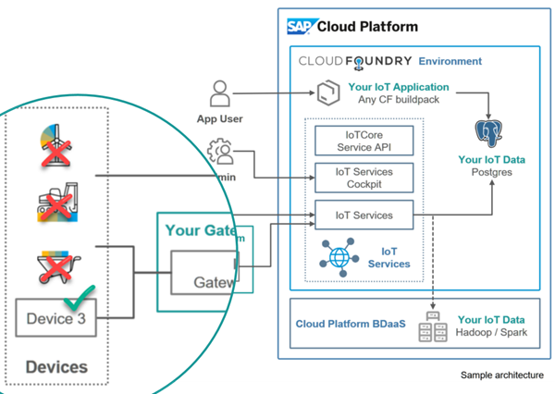
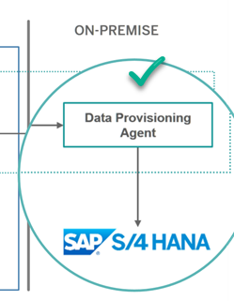
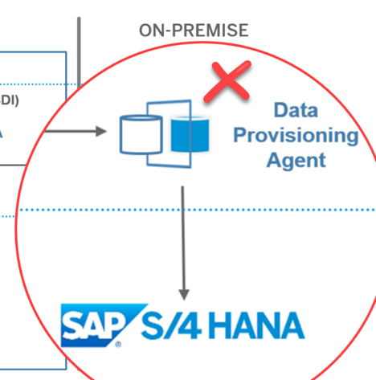
SAP Business Technology Platform Solution Diagram Design Guidelines Dos and Don’ts (1)
Don’t mix up different icon designs. For example, don’t use SAP banded-color icons with SAP Business Technology Platform solution icons in the same diagram.
Don’t create own new icons, use simple text boxes instead. Request new icons in the SAP Business Technology Platform User Community

Slide 34
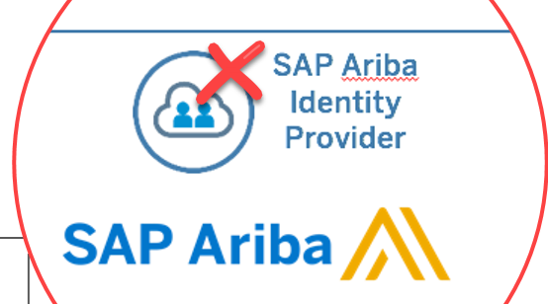
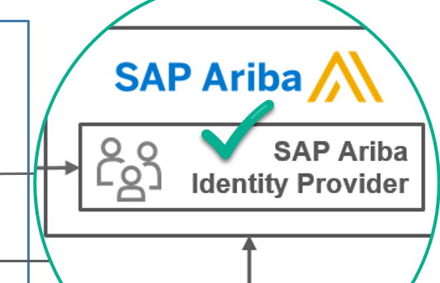
SAP Business Technology Platform Solution Diagram Design Guidelines Author Guidelines: Dos and Don’ts (2)
Don’t reuse SAP Business Technology Platform service icons outside the SAP Business Technology Platform environment; use text boxes instead.

Slide 35
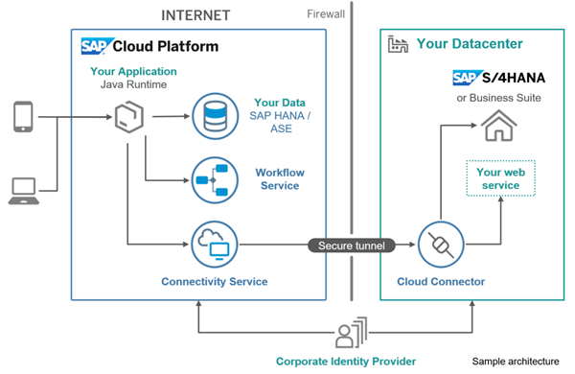
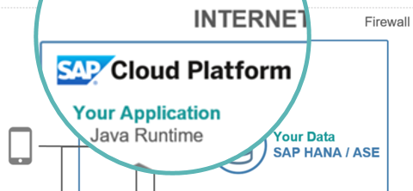
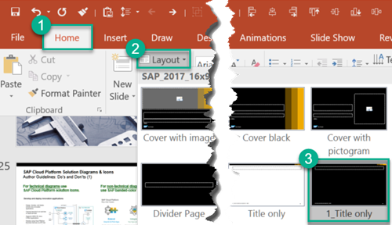
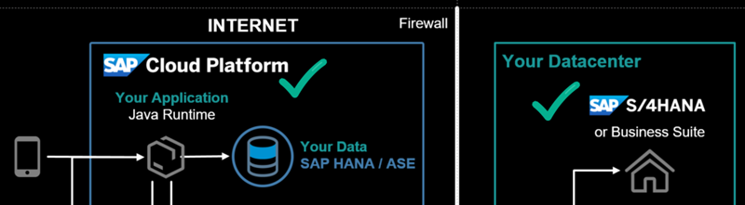
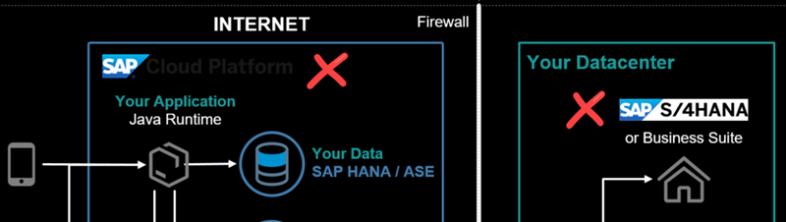
SAP Business Technology Platform Solution Diagram Design Guidelines Dos and Don’ts (4)
Use emphasis colors to visually highlight important parts of the solution diagram.
Replace logo images when you switch to a black background style*.
* [On Windows] Select slide layout with shortcut ALT+H and L
3
1
2
4
5

Slide 36

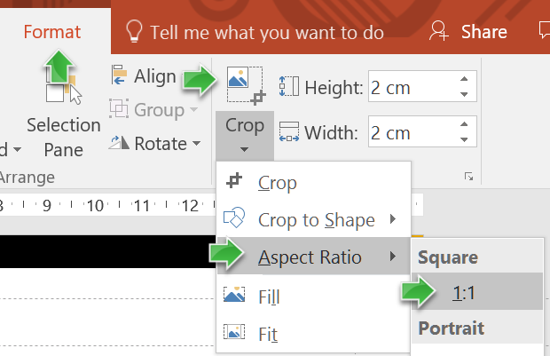
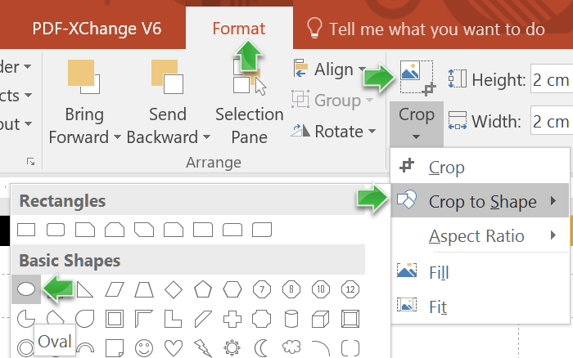
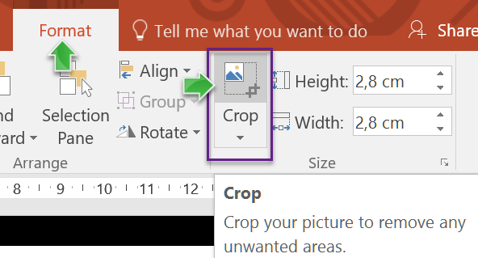
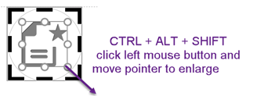
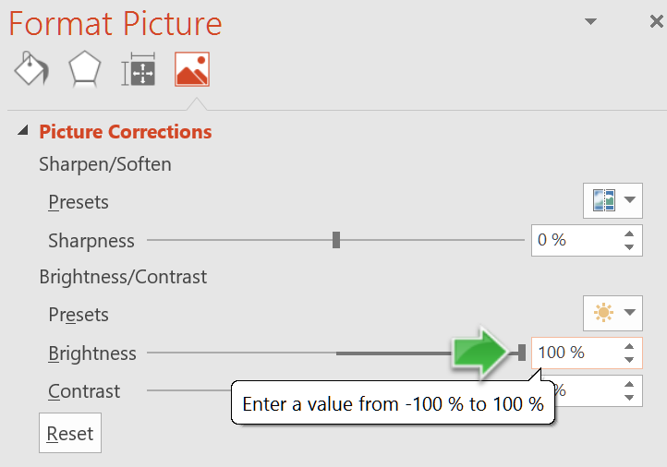

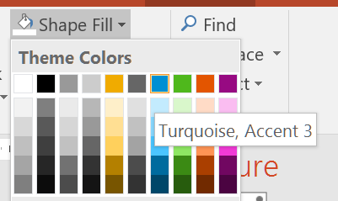
SAP Business Technology Platform Solution Diagram Design Guidelines How to Create Colored Icons in Five Steps (from PNG icon, does not apply to SVG) Solution Diagram example with colored icons: see slide SAP Business Technology Platform Solution Diagram Examples > Principal Propagation
1
Set aspect ratio to 1:1
2
Crop to shape “circle”
3
Enlarge crop area
start with grey icon
5
Set 100% brightness
4
Fill shape with color
end with colored icon

Slide 37
SAP Business Technology Platform Solution Diagram Design Guidelines Tips and Tricks for using Microsoft PowerPoint (1)
[On Windows] Use little-known keyboard shortcuts for fast editing
MUST USE THIS! Copy and paste one or many shapes/texts/objects to one or many selected (or highlighted) other ones using CTRL+SHIFT+C and CTRL+SHIFT+V.
Duplicate an object using CTRL+D or CTRL+SHIFT+Left Mouse Button.
Center text using CTRL+E. Left or right align using CTRL+L or CTRL+R.
Clear all formatting using CTRL+Spacebar.
Group objects using CTRL+G. Ungroup using CTRL+SHIFT+G.
[On Mac] Use little-known keyboard shortcuts for fast editing
MUST USE THIS! Copy and paste one or many shapes/texts/objects to one or many selected (or highlighted) other ones using CMD(⌘)+SHIFT+C and CMD(⌘)+SHIFT+V.
Duplicate an object using ⌘+D.
Center text using ⌘+E. Left or right align using ⌘+L or ⌘+R.
Clear all formatting using ⌘+Spacebar.
Group objects using ⌘ +ALT+G. Ungroup using ⌘ +ALT+SHIFT+G.

Slide 38



SAP Business Technology Platform Solution Diagrams Design Guidelines Comparison with SAP TAM Block Diagrams (1)
SAP TAM Block Diagrams |  | SAP Business Technology Platform Solution Diagrams
Purpose: Most important diagram type for describing architecture. Show the static structure of the system, and provide a big picture view. |  | Purpose: Domain-specific diagram type that describe SAP Business Technology Platform solution scenarios across IT landscapes. Show SAP Business Technology Platform services, environments, systems, and their interdependencies.
Agents process information, communicate via channels, access storage |  | Agents, systems, SAP Business Technology Platform services depicted as blue circled icons, gray icons, or colored boxes
Storage elements contain information accessed by agents. |  | Storage visualized either as corresponding SAP Cloud Platform database as a service icon or as rounded box for non-SAP-BTP storages (for example, an on-premise database).
Channels transport information between agents Request-response channels show the direction of a request, indicating the triggering agent (=the Client) Modifying Access: “A” can read and write storage content Read-only Access: “A” can only read storage content |  | Arrows express “interdependencies” between services, components, users, or systems. Interdependencies include request/response channels, usage relations, data flows (for example, data replication, using a dashed line), or trust relations. The standard interdependency is a request/response channel that points from client to server (using a solid line arrow). For mutual relations like a mutual trust relation from one system to another, a bidirectional, solid line arrow is used. There is no visual difference between modifying and read-only access types; use text annotation to provide additional details that are not represented visually (for example, a modifying read and write access), or use TAM block diagrams instead. See the previous slide for more details on arrow directions.
Notes: Use class diagrams to show how data is located in storages or exchanged via channels. Use activity or sequence or state diagrams to express the behavior of agents and how they interact. |  | Notes: Use SAP TAM Diagrams for more technically detailed SAP Business Technology Platform solution architectures.
Agent
SAP BTP service
User Persona
Agent
Storage
Storage
SAP HANA Database
A1
A2
Client
R
Server
A
S
A
S

Slide 39

SAP Business Technology Platform Solution Diagrams Design Guidelines Comparison with SAP TAM Block Diagrams (2)
SAP TAM Block Diagram Example
SAP Business Technology Platform Solution Diagram Example
Customers
Customers
...
...
Register Edit Profile Browse Orders
Search Get Prod. Info Select Items
Place Order Cancel Order
Register Edit Profile Browse Orders
Search Get Prod. Info Select Items
Place Order Cancel Order
R
R
R
Service Provider
Online Shop: SAPUI5 Applications
Online Shop Server
Service Provider
Customer Account Maintenance
Product Presentation + Selection
Order Processing
Credit Card Institutions
Customer Account Maintenance
Product Presentation + Selection
Order Processing
R
Credit Card Institutions
Shipping
Shipping
Customer’s product selection
Customer’s product selection
SAP HANA service
REST
...
...
Connectivity
Credit Card Institutions
Suppliers
ERP data
...
SAP S/4HANA on-premise
Firewall
Customer data
Product Information
Product Availability
Orders
Shop Data
OData
Cloud
Connector

Slide 40
SAP Business Technology Platform Solution Diagrams Samples

Slide 41







SAP Business Technology Platform Solution Diagram Samples
Source: openSAP course “An Enterprise Architect’s View on SAP Business Technology Platform” : https://open.sap.com/courses/ea2, Lean Enterprise Architecture Toolkit Templates, version 1.0, 2021-Feb
Legend:
Request response:
Information flow from source to target:
Custom development
* existing component
** SAP Discovery Center URL: https://discovery-center.cloud.sap/
Request & Approval Solution
Request & Status Application
Enterprise Architect
SAP Discovery Center**
services and missions
SAPUI5 App
Java App
Cloud Foundry Runtime
Review & Approve Application
Firewall
Rocket Chips Data Center
HTTP
Launchpad Service*
SAPUI5 App
Java App
SAP Analytics Cloud, embedded edition*
Secure tunnel
Application Clients
Cloud Connector
Live
SAP BW/4HANA
Identity Authentication Service
Workflow Management
Business Rules
SAP HANA Cloud
Rocket Chips Identity Provider

Slide 42






SAP Business Technology Platform Solution Diagram Samples SAP Fiori Cloud
INTERNET
Firewall
End User
Your Datacenter
Consumer subaccount (customer)
or Business Suite
Design time environments
OData Provisioning*
SAP Gateway*
Application Client
Fiori Configuration Cockpit (FCC)
UI theme designer
SAP Application Studio
SAP Build
iOS
subscribed Fiori Cloud apps and content
option 1
option 2
Secure tunnel
Android
Portal
SAP Fiori launchpad
Connectivity service
Cloud connector
Windows
Provider account (SAP)
trust
SAP Fiori Cloud applications & content packages
Identity Authentication tenant
Desktop
* OData services via SAP Business Technology Platform OData provisioning or SAP Gateway (see details about deployment options in SAP Note 1830712)
Notes:
Enable modern and intuitive user experience for SAP users
Quickly deploy packaged content for SAP S/4HANA and Business Suite
Design, develop, extend and mobilize SAP Fiori apps in the cloud
Extend apps using SAP Web IDE Fiori extension model
Connect securely via internal or external access point
Operations and updates by SAP

Slide 43












SAP Business Technology Platform Solution Diagram Examples Principal Propagation
Note: For practical details see Author Guidelines: How to create Colored Icons in 5 Steps
INTERNET
Firewall
ON-PREMISE CORPORATE NETWORK
Client
Secure tunnel
5
Operating System (OS)
Company root CA
: John Doe
: John Doe
Cloud Connector
SAP Gateway
Private root CA
Cloud Connector system
Server SSL standard
Cloud Connector UI
Private root CA
Cloud Connector local CA
1
: John Doe
6
Operating System (OS)
: John Doe
Company Root CA
: John Doe
SAP Web IDE
SAP Backend
2
4
Private Root CA
: John Doe
Identity Authentication service
Application
LEGEND
Certificate signed by the Cloud Connector local CA*
Certificate
Identity from the Identity Provider
Certificate signed by the
private root CA*
Root certificate
Identity from the SAP system
3rd party Identity Provider
3
: John Doe
Intermediate or
CA* certificate
Certificate signed by the
company root CA*
Short-lived certificate
*CA: certificate authority

Slide 44

SAP Business Technology Platform Solution Diagram Examples Weather Demo: Developed Using the "Bring Your Own Language" Concept Browse Code Sample on GitHub: https://github.com/SAP/cloud-cf-byol-weather-sample
INTERNET
Cloud Foundry Environment
deploy
App Developer
Client-side Application Staticfile CF buildpack
Server-side Application Community CF buildpack
Application Client
Weather Report App Scala.js
send on startup
HTTPS
GeoNames.org
geographical database
End User
Weather Report App Scala.js
GeoServer Erlang
OpenWeatherMap.org
OpenStreetMap.org

Slide 45
SAP Business Technology Platform Solution Diagrams & Icons: Resources

Slide 46
SAP Business Technology Platform Solution Diagrams & Icons Resources
Be Visual! Use Official Icons and Samples for SAP Cloud Platform Solution Diagrams sap.com community blog, January 5th 2018
Download latest Solution Diagram Guidelines and a set of SAP Business Technology Platform icons (as zipped SVG and PNG files) here: SAP Business Technology Platform Solution Diagrams & Icons wiki
SAP Business Technology Platform Products and their Capabilities (high level overview): https://www.sap.com/products/business-technology-platform/products.html
SAP Business Technology Platform Discovery Center including Missions and Service Catalog (service details): https://www.discovery-center.cloud.sap/
SAP Business Technology Platform Use Cases containing solution diagrams https://www.sap.com/products/business-technology-platform/use-cases.html
openSAP eLearning course, new in 2021-Jan: “An Enterprise Architect’s View on SAP Business Technology Platform” (includes units on specific diagram flavors named “solution architecture”, “solution concept”, “solution realization diagram” and “software distribution diagram”): https://open.sap.com/courses/ea2

Slide 47
SAP Business Technology Platform Solution Diagrams Icons: Version Changes NOTE: For changes in previous versions see wiki.scn.sap.com page SAP Business Technology Platform Solution Diagrams & Icons

Slide 48
What's New in SAP Business Technology Platform Solution Diagrams & Icons Guidelines v01 from March 26, 2020 For changes in previous versions see wiki.scn.sap.com page SAP Business Technology Platform Solution Diagrams & Icons
GENERAL
Major changes: names and titles rebranded from SAP Cloud Platform to SAP Business Technology Platform
Version number: after rebranding the guideline version number again starts with v01
ICONS
New service icons
Extension Suite - Development Efficiency: Kyma Runtime, Product Configuration, Market Rates Management, Market Rates Management - Bring Your own Rates data option, Product Configuration, SaaS Provisioning Service, Serverless Runtime, Usage Data Management, Service Management (former name Service Manager)
Extension Suite - Development Efficiency: Cash Application, Intelligent Business Process Management, SAP Intelligent RPA
Extension Suite - Digital Experience: AI Cockpit, AI Core, Print, SAP Work Zone, UI Theme Designer
Integration Suite: Integration Suite
Renamed service icons:
Extension Suite - Development Efficiency: Service Management (former name Service Manager)
New other icons: sap-ui5 (color).png
OTHER
Number elements: n/a
SAP LOGOS
Deprecated, removed: SAP C/4HANA is now SAP Customer Experience solutions
New: n/a
Modified: n/a
3rd PARTY LOGOS
Modified: n/a
GUIDELINES
Updated: n/a
SAMPLE DIAGRAMS
General: rebranded to SAP BTP
RESOURCES
New: link to openSAP course “An Enterprise Architect’s View on SAP Business Technology Platform”
VERSION CHANGES
New: n/a

Slide 49
What's New in SAP Business Technology Platform Solution Diagrams & Icons Guidelines v09 from May 15, 2020 For changes in previous versions see wiki.scn.sap.com page SAP Business Technology Platform Solution Diagrams & Icons
GENERAL
Major changes: separated all SAP Business Technology Platform service icons to ZIP resource with PNG and SVG files (folder structure follows new SAP Business Technology Platform capability categories “Extension Suite” and “Integration Suite”) / Colors of service icons and solution diagram elements updated to new SAP Fiori Quartz colors.
ICONS
New icon category: not provided
New service icons: not provided
Renamed service icons: not provided
New other icons: not provided
New extra icons: not provided
OTHER
Number elements: added alternative numbers in trapezoid shape to depict numbered descriptions of a “solution flow”
SAP LOGOS
Deprecated: n/a
New: n/a
Modified: n/a
3rd PARTY LOGOS
Modified: n/a
GUIDELINES
Updated: design guidelines updated to new SAP Fiori Quartz colors
SAMPLE DIAGRAMS
General: subset of former sample diagrams was redesigned following the new SAP Business Technology Platform solution diagram guidelines (new service icons, new color set, new grey SAP icons)
New: added sample diagram from openSAP course “An Enterprise Architect’s view on SAP BTP”
RESOURCES
New: SAP Business Technology Platform Discovery Center
New: SAP Business Technology Platform icon collection (ZIP resource)
VERSION CHANGES
New: n/a

